Slide 1


Grand Rapids
Market Overview and Media Kit

Slide 2






Grand Rapids
Grand Rapids Profile
POPULATION BREAKDOWN
200,217
KEY STATISTICS
42%
$44K
63%
51% Female / 49% Male
Median Age: 31
Caucasian
African American
Hispanic/Latino
Asian
Other/Mixed
67.1%
19.9%
9.9%
2.1%
1%
College Graduate
Median HHI
Employed
19m
42%
41mi
Time Spent Traveling to Work
Take Public Transportation
Total Miles Traveled Per Week

Slide 3



Grand Rapids
Grand Rapids Profile
THINGS TO DO AND SEE
Events and Attractions
Gerald R. Ford Presidential Library, John Ball Zoo, Grand Rapids Art Museum, Grand Rapids Public Museum, Grand Rapids Civic Theatre, TreeRunner Adventure Park, DeVos Performance Hall, Van Andal Arena
Sports
Grand Rapids Drive (NBA D League), Grand Rapids Griffins (NHL Affiliate), West Michigan Whitecaps (MiLB)
Higher Education
Grand Valley State, Calvin College, Aquinas College, Cornerstone University, Davenport University, Hope College
With over 80 breweries in the city, Grand Rapids was named the Best Beer Town by USA Today!
Ranked the #1 Minor League Sports Market in the US by Sports Business Journal!

Slide 4
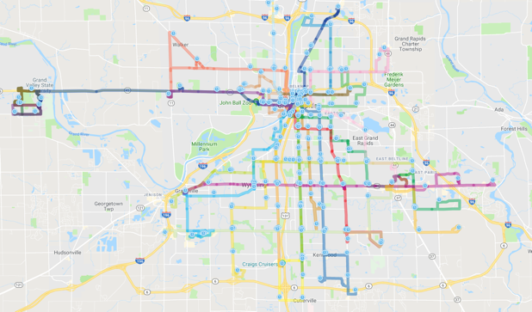
Grand Rapids
The Rapid Overview
As the second largest city in Michigan, The Rapid public transportation currently services East Grand Rapids, Grand Rapids, Grandville, Kentwood, Walker, Wyoming, and a portion of townships including Alpine, Byron, Gaines, and Cascade!
Buses travel over 6 million miles annually throughout the region and reach over 1MM people, providing the opportunity for advertisers to deliver their message directly to consumers daily where no other outdoor advertising exists.
Fast Transit Facts:
2019 Ridership: 10.4 million riders per year
Routes: 28 fixed routes across the six-city area focusing on Downtown Grand Rapids and the surrounding towns
Free transportation shuttle available within the core downtown area of Grand Rapids

Slide 5
Why Transit?
HIGHLY EFFECTIVE
Transit provides a variety of unmissable advertising sizes and opportunities either on the interior or exterior of the buses that present ‘billboards-on-wheels’ right at consumer eye-level
COMPLETE COVERAGE
Transit captures attention where people live, shop, work and play. Visible in both downtown business centers and upscale suburbs, these displays provide local, regional and national advertisers a competitive advantage to other OOH formats
REACH
With fragmented media sources competing for smaller and smaller audiences, transit advertising delivers some of the strongest CPM’s in advertising and reaches consumers far more effectively than other media.
FREQUENCY
Transit advertising targets your market all day: during the drive to work, walk to lunch and bike ride before dinner. Repeated viewing creates top-of-mind awareness and brand recognition in any media campaign.

Slide 6
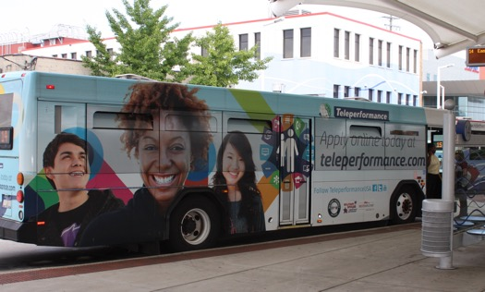
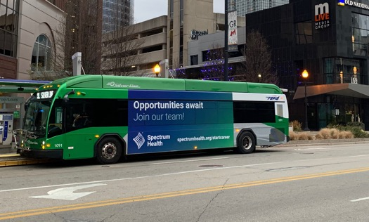
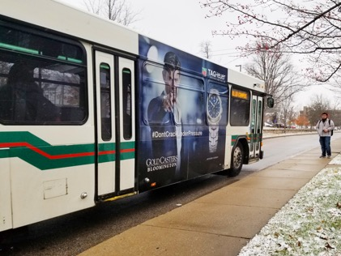


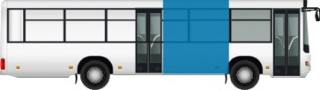
Grand Rapids
Available Formats – Impact Media
*Cost below are per month
**Pricing efficiencies are available for larger buys. Please reach out to your rep for more information
Full Bus Wraps – Own The Entire Bus!
# of Units | 1 Year | 2 Years | 3 Years
1 | $1,925 | $1,650 | $1,375
King Kongs – Driver Side Wraps
# of Units | 3 Months | 6 Months | 12 Months
1 | $825 | $770 | $715
Queen Kongs – Passenger Side Wraps
# of Units | 3 Months | 6 Months | 12 Months
1 | $550 | $495 | $440
Production of $7,200 included for contracts 3 years or more
Production: $1,300 per wrap
Production: $925 per wrap

Slide 7
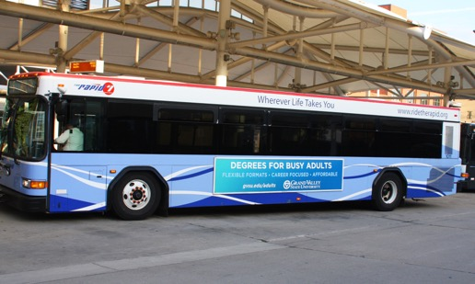
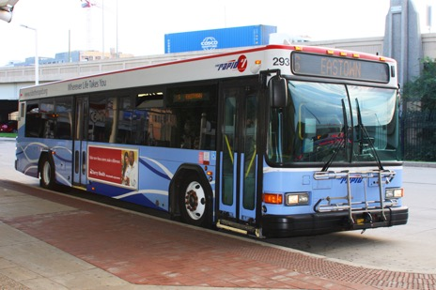
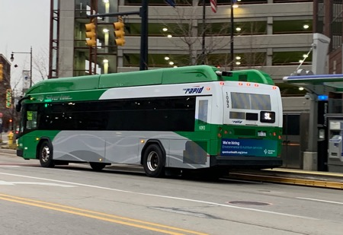



Grand Rapids
Available Formats – Frequency Media
*Cost below are per month
**Pricing efficiencies are available for larger buys. Please reach out to your rep for more information
King Panels – Ads On Driver Side Of Bus
# of Units | 1 Month | 6 Months | 1 Year
1 | $440 | $415 | $385
Queen Panels – Ads On Passenger Side Of Bus
# of Units | 1 Month | 6 Months | 1 Year
1 | $330 | $300 | $275
Tail Panels – Ad On The Back of Bus
# of Units | 1 Month | 6 Months | 1 Year
1 | $250 | $235 | $220
Production: $325 per panel
Production: $250 per panel
Production: $200 per panel

Slide 8
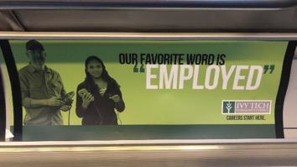
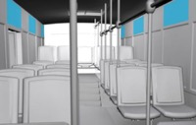
Grand Rapids
Available Formats – Interior Signage
*Cost below are per month
**Pricing efficiencies are available for larger buys. Please reach out to your rep for more information
Interior Cards – Ads Inside The Bus
# of Units | 3 Months | 6 Months | 12 Months
10 | $280 | $280 | $220
Production: $25 per panel

Slide 9
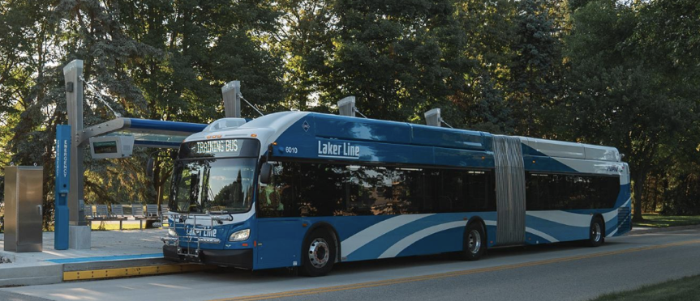
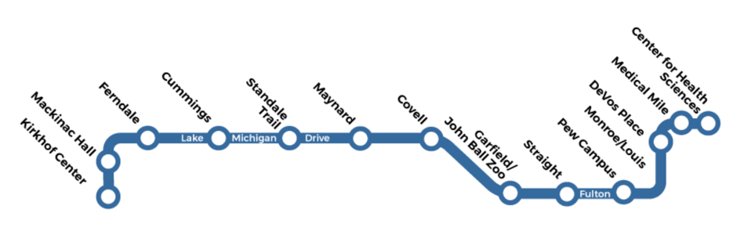
Grand Rapids
New Advertising Opportunity
Laker Line
Exclusive, first-ever opportunity to place advertising on 60’ articulated buses with dedicated routes between downtown Grand Rapids and the GVSU campus in Allendale, fostering enhanced connections along the Lake Michigan Drive and Fulton Street corridors!
With only (16) buses, this opportunity to guarantee coverage on the newest, largest buses in market will guarantee your ad has the best possible chance to be seen!
Buses only run on the Laker Line route, guaranteeing strong coverage throughout Grand Rapids and Allendale
Advertisers can run bus kings and queens
Potential to dominate one bus or spread your ads out across the fleet

Slide 10
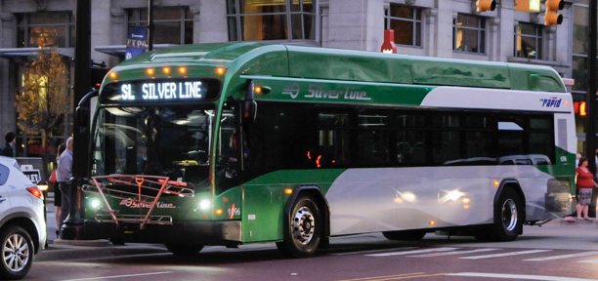
Grand Rapids
New Advertising Opportunity
Silver Line
Exclusive, first-ever opportunity to place advertising on Silver Line buses running between downtown Grand Rapids south down the Division St Corridor to Kentwood and Wyoming!
With only (10) buses, this opportunity to guarantee premium advertising coverage coverage will allow your ad to blanket downtown and reach an often overlooker part of Grand Rapids!
Buses only run on the Silver Line route, guaranteeing the most coverage across downtown Grand Rapids
Advertisers can run bus kings, bus queens, and bus tails
Potential to dominate one bus or spread your ads out across the fleet

Slide 11
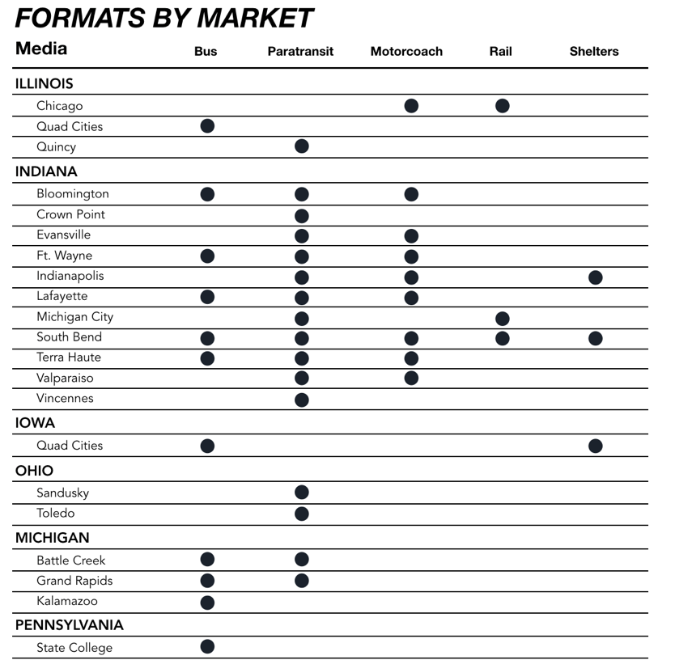

Mesmerize
AVAILABLE FORMATS BY MARKET

Slide 12
Thank You!
Please reach out to Evan Gordon (evan@mesmerize.com)

