Slide 1
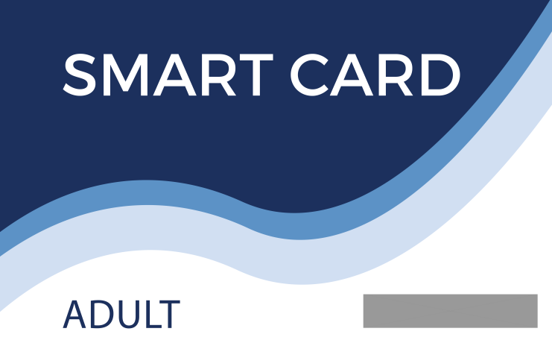
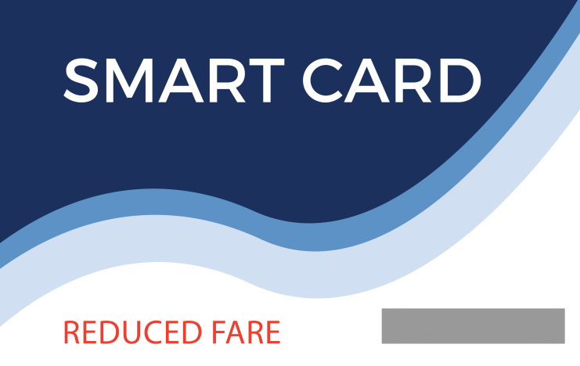
2017 e -FARE SYSTEM PRESENTATION

Slide 2
The Rapid e – Fare System
What is it?
A new way for passengers to pay their fares
The best fare system for EVERY rider
A tool to speed boarding at bus stops
A way to eliminate the printing of 1.7 million transfers each year

Slide 3
e – Fare vs. Our Current System
Today:
Value is on the card, itself
Passes store a period of time or a number of rides
31 days/ 7 days/ 1 day or 10 rides encoded on card
Lost card = lost money
The Future – the Electronic Fare System
e – Fare is an account-based system
Just like a debit card, it connects to an account via a number on the card
If the card gets lost or stolen, you just get a new one that connects to the account
Passengers can register their account through an online system

Slide 4
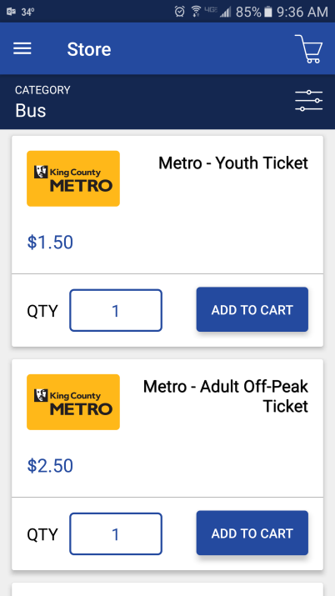
How will passengers pay their fare on the bus?
e-fare Smart Card
e-fare smart card can be purchased online, at the Rapid Central Station (RCS) Information Center, at one of 38 ticket vending machines or at a retail outlet.
e-fare Smartphone App
Can access from the mobile app or online
Apple and Android versions

Slide 5
What makes the new system good for you?
Capped Fares
With the e-fare system, you buy a pass one trip at a time – a true Pay-as-you-go system
No big upfront cost – put as much as you want in your account
You never pay for a trip you don’t take, which can happen with a period based pass
The e-fare capped fare system will give YOU the best deal on your fare based on how much you ride.
Earn a 1-Day pass after riding twice in 1 day ($3.50)
Earn a 7-Day pass after riding 9 times in 7 days ($16.00)
Earn a 31-Day pass after riding 27 times in 31 days ($47.00)

Slide 6
What makes the new system good for you?
For example, once you've reached the cost of a monthly pass, you can ride as if you have a 31-Day pass. The same with 7-Day and 1-Day passes. So everyone gets the savings of a pass without the upfront cost.
Your account can be reloaded in many ways:
With cash/credit/debit at a retail location
With cash/credit/debit at The RCS Information Center
Automatically by linking your online account to a debit or credit card
With cash/credit/debit at a Ticket Vending Machine

Slide 7
Fare Categories
Rider Category | Current Fare Structure | Proposed e-fare Fare Structure
Adult | Anyone | No Change
Reduced Fare | Over 65 and people with disabilities | No change
Student | Anyone enrolled at any educational institution (e.g. GVSU, GRPS, GRCC, Aquinas, etc.) | Will change to an e-fare Partner program with e-fare cards issued by the schools
Youth | No youth program currently | Anyone over 42” in height and age 19 or under
e-fare Partner Program | Unique magnetic stripe card (e.g. Spectrum Health, Grand Rapids Parking Services, GVSU, etc.) | Unique partner e-fare smart cards will be used

Slide 8
The Rapid Fare Structure
CURRENT FARE STRUCTURE
PROPOSED CAPPED FARE STRUCTURE
Categories | Cash fare | 10 Ride | 31 day | 7 day | 1 day
Adult | $ 1.75 | $ 13.50 | $ 47.00 | $ 16.00 | $ 3.50
Reduced | $ 0.85 | $ 8.50 | $ 30.00 | ---- | ----
Student | ----- | $ 10.50 | ----- | ----- | -----
Categories | Cash fare or Cap Increment | 10 Ride | 31 day | 7 day | 1 day
Adult | $ 1.75 | ----- | $ 47.00 | $ 16.00 | $ 3.50
Youth | $ 1.25 | ----- | $ 33.75 | $ 11.25 | $ 2.50
Reduced | $ 0.85 | ----- | $ 30.00 | $ 10.50 | $ 2.25
Partner/Student | $ 1.25 | ----- | ----- | $ 11.25 | -----

Slide 9
A change in the way we think about transfers – Buying time on The Rapid, not just a ride
Current System
Transfers issued by bus drivers on request – delays boarding and delays the bus
Transfers can currently only be used to continue a trip on a different route
1.7 million transfers are issued to riders each year – but only 1.3 million transfers are used. Paper for the transfers cost us $71,400 per year, of which $16,800 is wasted on 400,000 unused transfers.
Proposed System
e-fare system users will get to use any fixed route service for 90 minutes when they pay their fare – no limits on getting back on the same route
Riders will, in essence, be buying the use of the system for a period of time instead of for a given trip
Eventually, we will discontinue the issuance of paper transfers for cash fare riders – you’ll have to use an e-fare card or mobile app

Slide 10
The Rapid e – Fare System
e – Fare will give YOU the lowest cost trip that
You have earned – it’s FAIR and EQUITABLE
e – Fare will greatly simplify the payment of fares
e – Fare will speed boarding on the bus, thus decreasing the amount of time the bus sits at a stop
e – Fare will phase out magnetic stripe tickets, an old technology that causes many problems on the bus
e – Fare will offer YOU many different ways to pay your fare
e – Fare will eventually eliminate paper transfers

